Slide 1
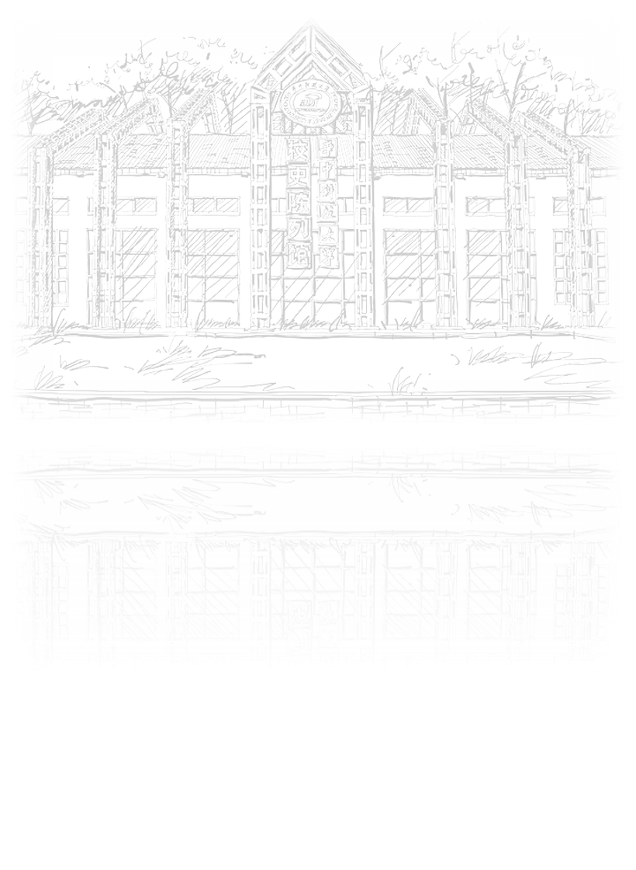
Gaze estimation
田博文

Slide 2
CONTENTS
01
02
03
Introduction
Reference
Dataset

Slide 3

1
Introduction

Slide 4
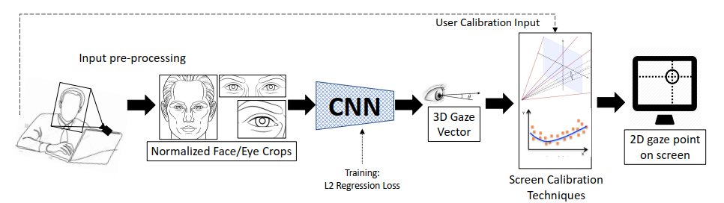
Gaze estimation
introduction
以眼睛图像或人脸图像为处理对象，估算人的视线方向或注视点位置

Slide 5
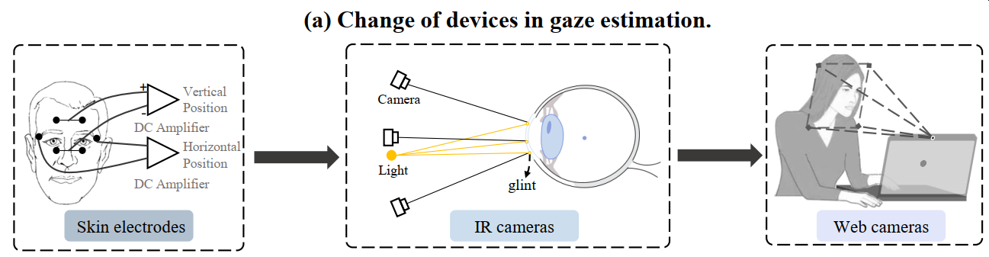
Gaze estimation
introduction

Slide 6
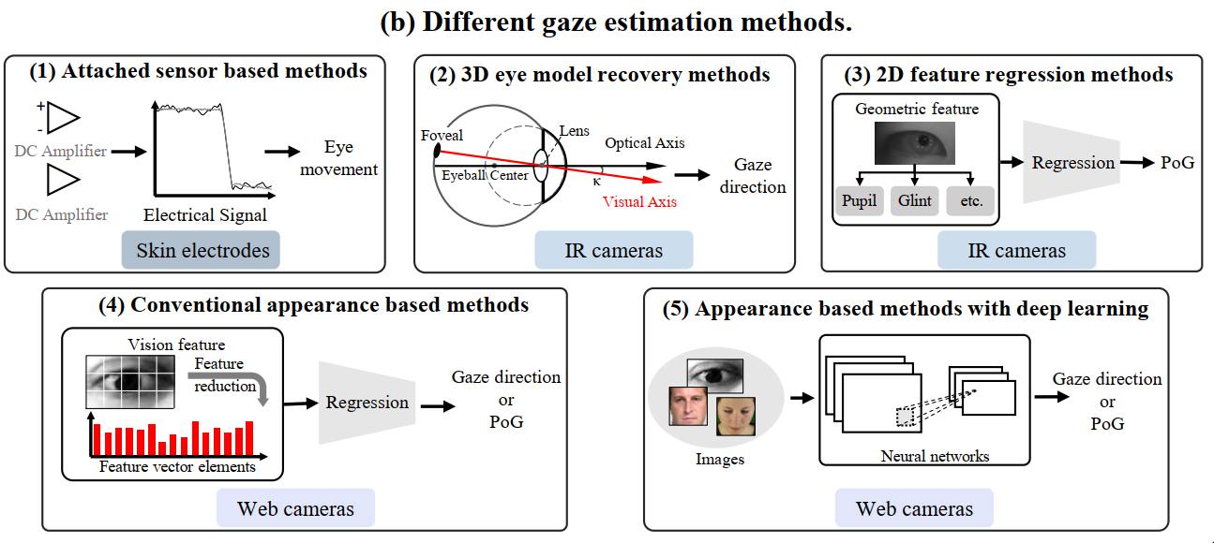
Gaze estimation
introduction

Slide 7
Gaze estimation
introduction
Why deep learning-based gaze estimation？
can extract high-level abstract gaze features
learns non-linear mapping function
tolerate head movement to some extent

Slide 8
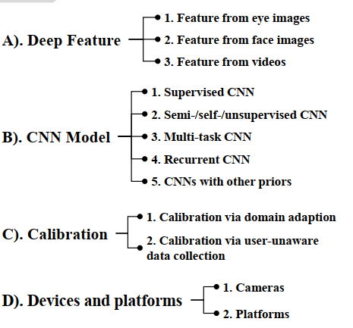
Gaze estimation
introduction

Slide 9
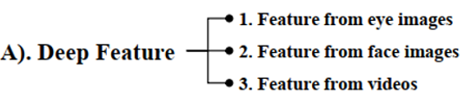
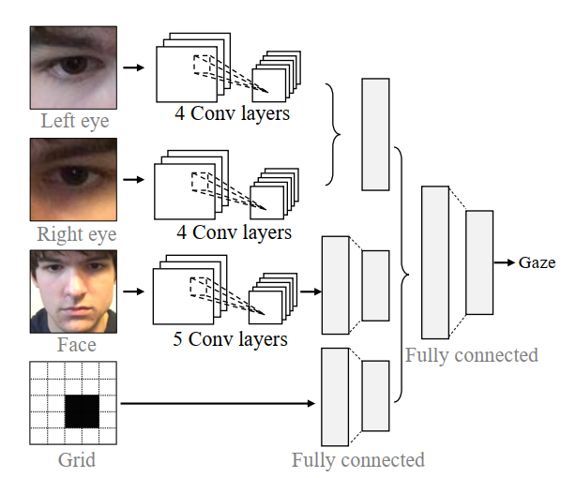
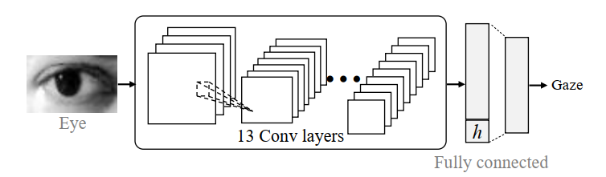
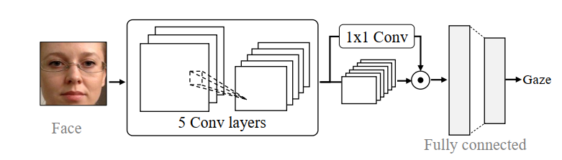
Gaze estimation
introduction
1.Gaze estimation with eye images
2.Gaze estimation with face images
3.Gaze estimation with face and eye images

Slide 10
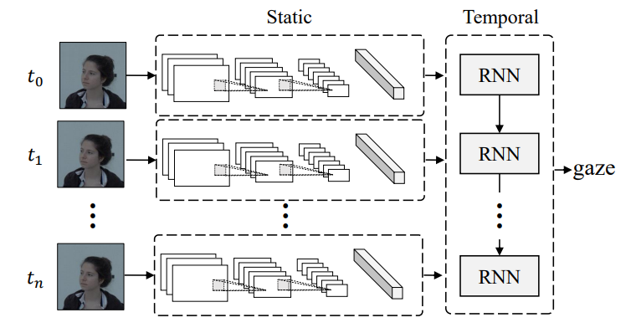
Gaze estimation
introduction
4.Gaze estimation with videos

Slide 11
2
Reference

Slide 12
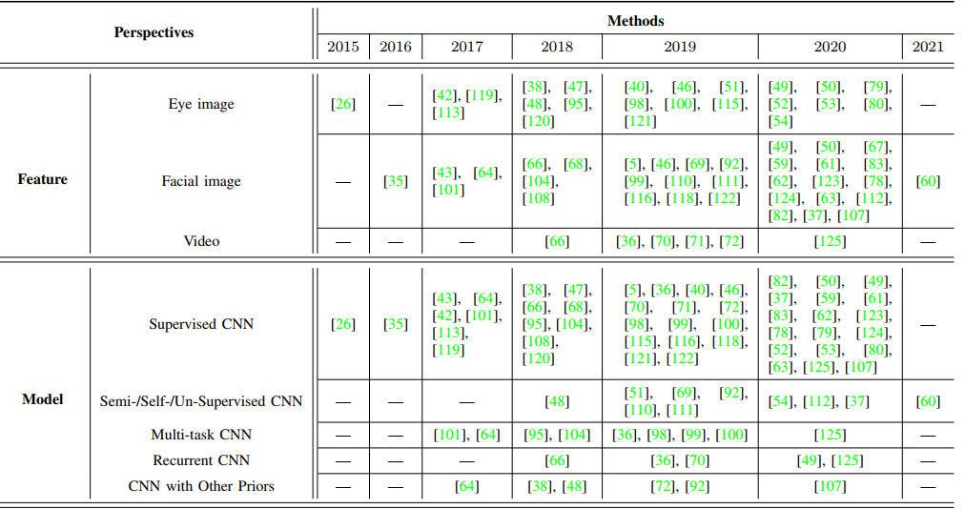
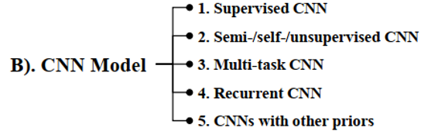
Gaze estimation
introduction
2019-12-CVPR-Momentum Contrast for Unsupervised Visual Representation Learning(MoCo)

Slide 13
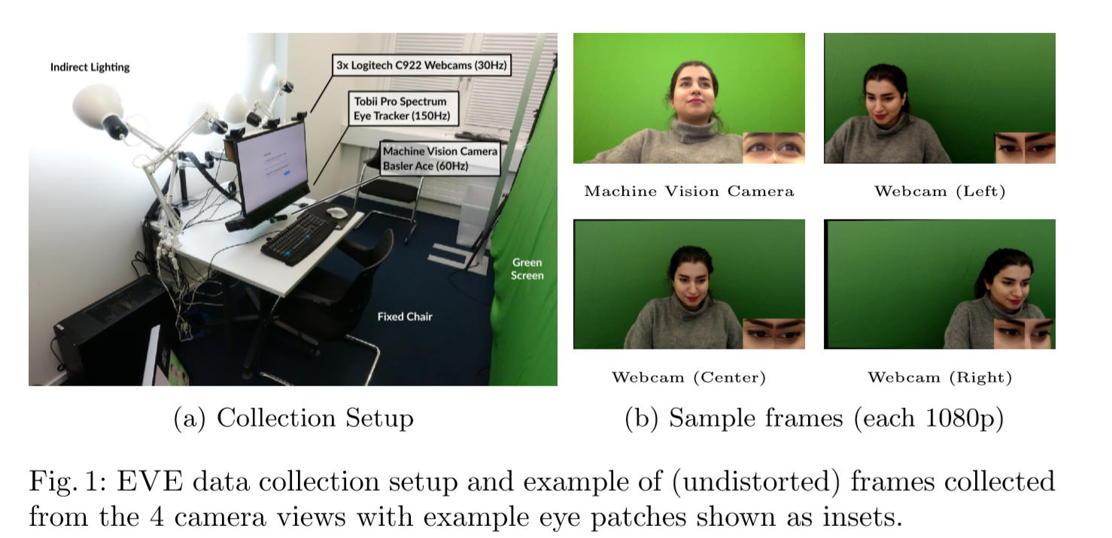
Xucong Zhang - Supervised
2020 Towards End-to-end Video-based Eye-Tracking

Slide 14
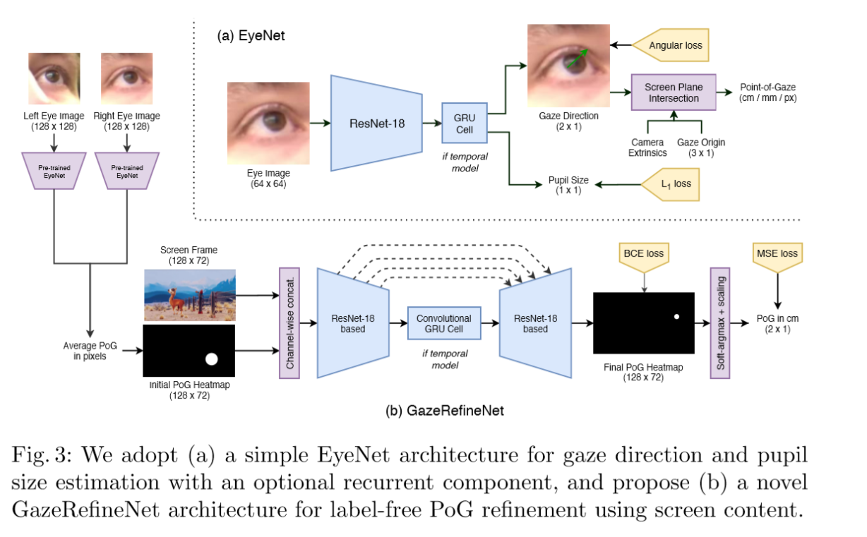
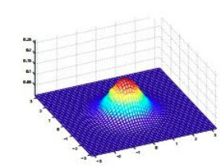
Xucong Zhang - Supervised
2020 Towards End-to-end Video-based Eye-Tracking
Code:https://github.com/swook/EVE
2.49°，2.75cm

Slide 15
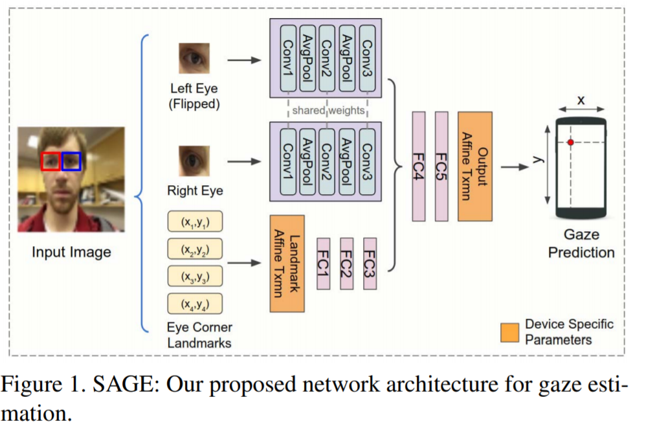
手机端
2019 On-device Few-shot Personalization for Real-time Gaze Estimation
Google对上述模型做了进一步压缩，即将人脸和人脸位置这两个输入替换为四个眼角的位置坐标，iPHone1.78cm
Notes:
眼角位置坐标不仅直接提供了眼睛位置信息，同时又暗含head pose信息（眼角间距越小，head pose越大，反之头部越正）。实验结果表明，这个精简后的模型在iPhone上的误差为1.78cm，与原始模型的精度相差无几。同时，该模型在Google Pixel 2 Phone的处理速度达到10ms/帧。

Slide 16
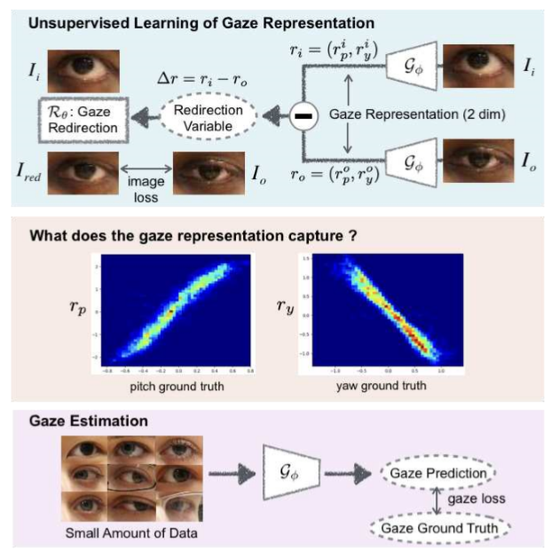
Idiap - unsupervised
2020 Unsupervised Representation Learning for Gaze Estimation

Slide 17
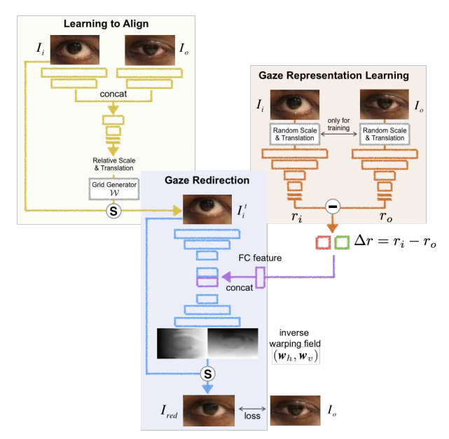
Idiap - unsupervised
2020 Unsupervised Representation Learning for Gaze Estimation
Notes:
背景，数据集标注的问题

Slide 18
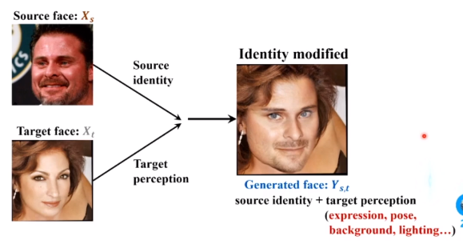
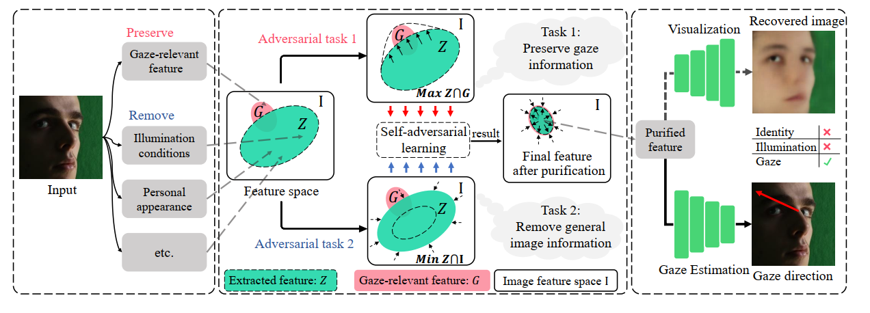
Lu Feng – self-supervised
2021 PureGaze: Purifying Gaze Feature for Generalizable Gaze Estimation
2021-CVPR-Information Bottleneck Disentanglement for Identity Swapping
Notes:
背景，数据集标注的问题

Slide 19
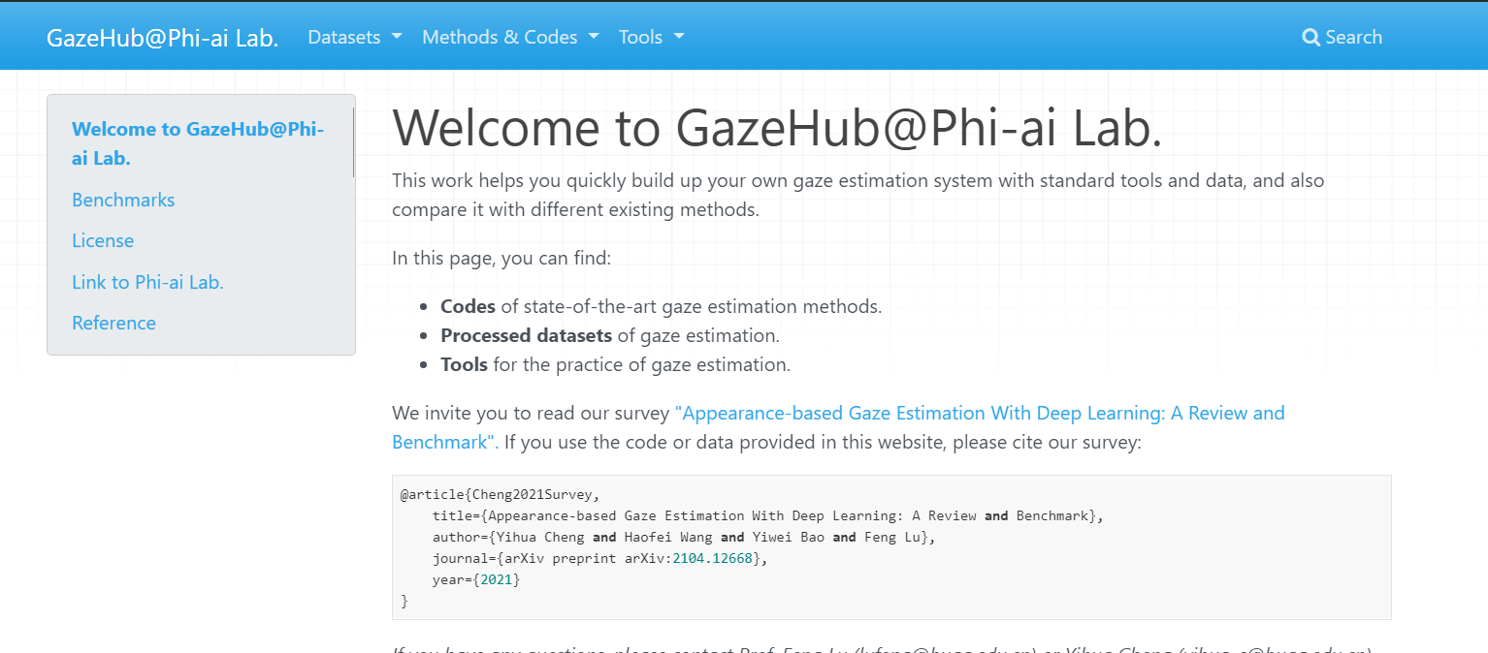
Gaze estimation
introduction
苏黎世理工 AIT Lab----https://ait.ethz.ch/index.php
洛桑联邦理工学院Idiap----https://www.idiap.ch/en
马克思普朗克研究所----https://perceptualui.org/
北京航天航空大学陆峰----http://phi-ai.org/default.htm
http://phi-ai.org/Gazehub/
https://github.com/RichardoMrMu/awesome-gaze-estimation-new
https://github.com/RichardoMrMu/gaze-estimation-paper

Slide 20

Gaze estimation
introduction
https://github.com/RichardoMrMu/awesome-gaze-estimation-new
https://github.com/RichardoMrMu/gaze-estimation-paper

Slide 21
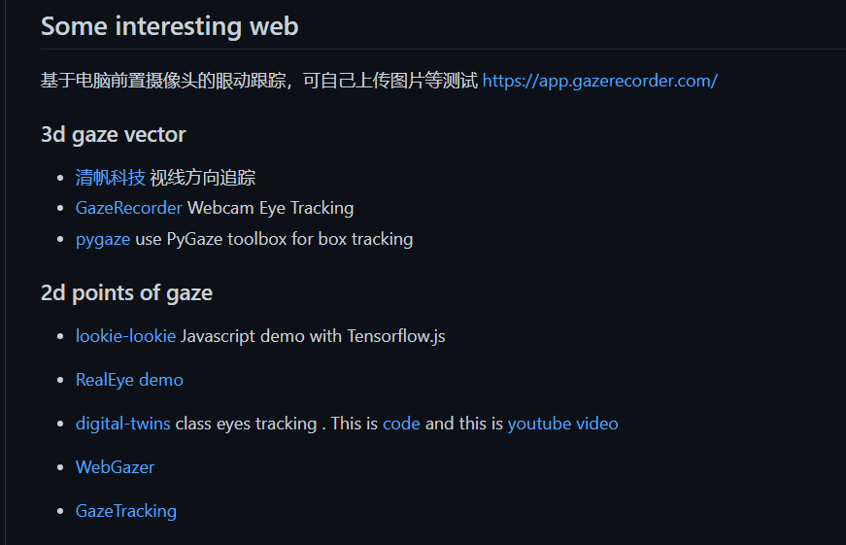
Gaze estimation
introduction
https://github.com/RichardoMrMu/awesome-gaze-estimation-new
https://github.com/RichardoMrMu/gaze-estimation-paper

Slide 22
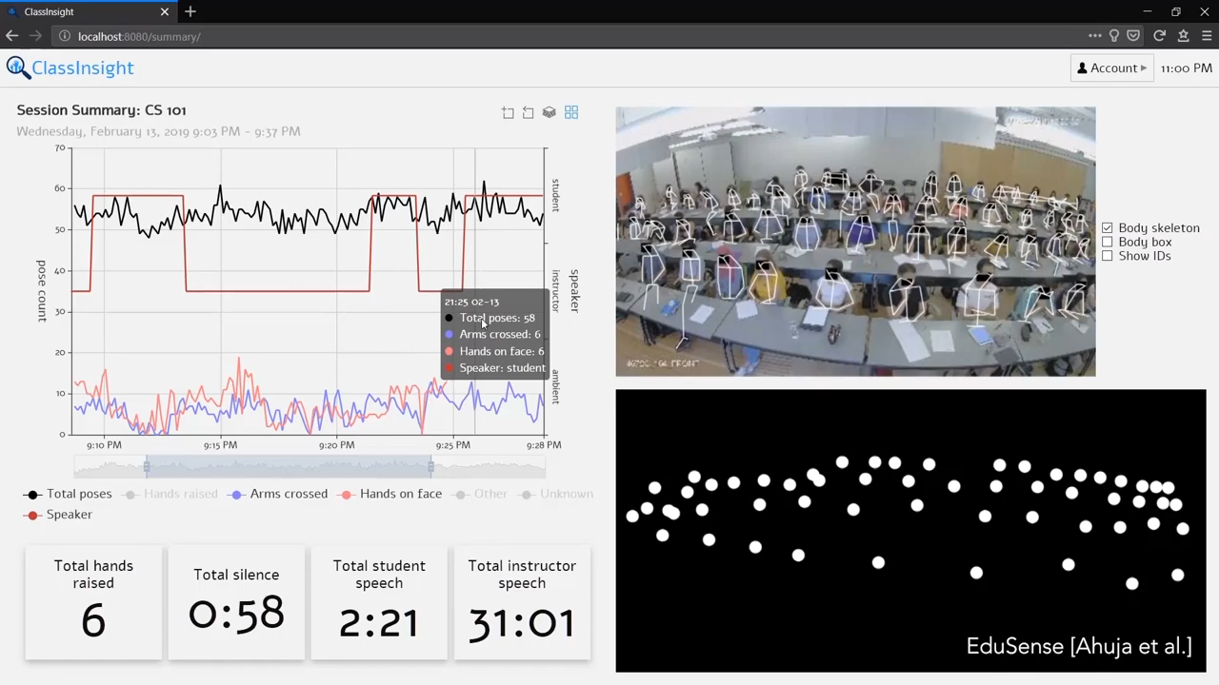
Gaze estimation
introduction
https://github.com/RichardoMrMu/awesome-gaze-estimation-new
https://github.com/RichardoMrMu/gaze-estimation-paper

Slide 23
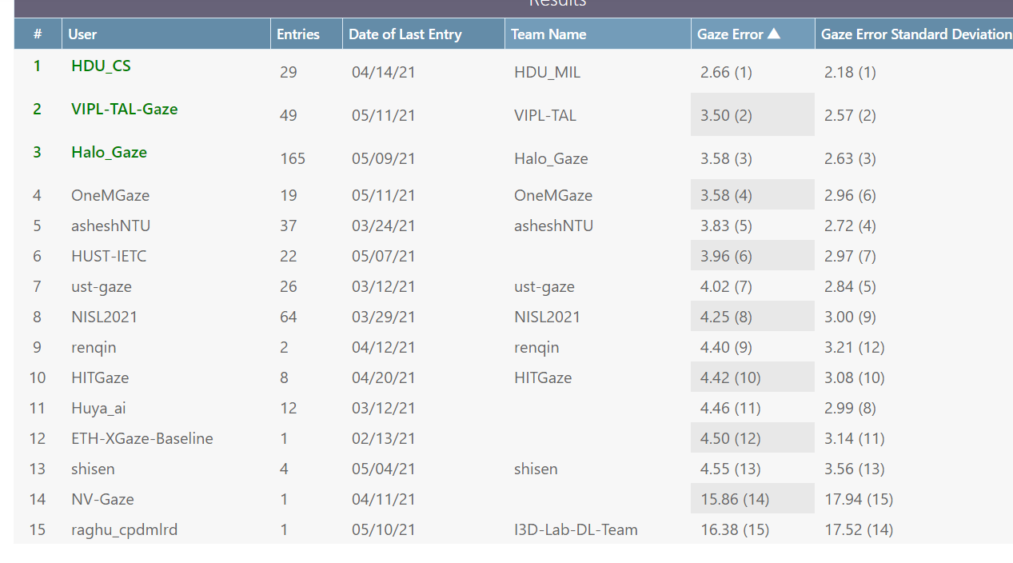
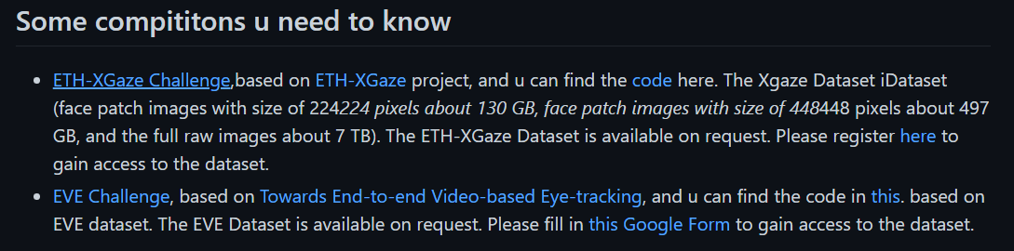
Gaze estimation
introduction
https://github.com/RichardoMrMu/awesome-gaze-estimation-new
https://github.com/RichardoMrMu/gaze-estimation-paper

Slide 24
3
Dataset

Slide 25
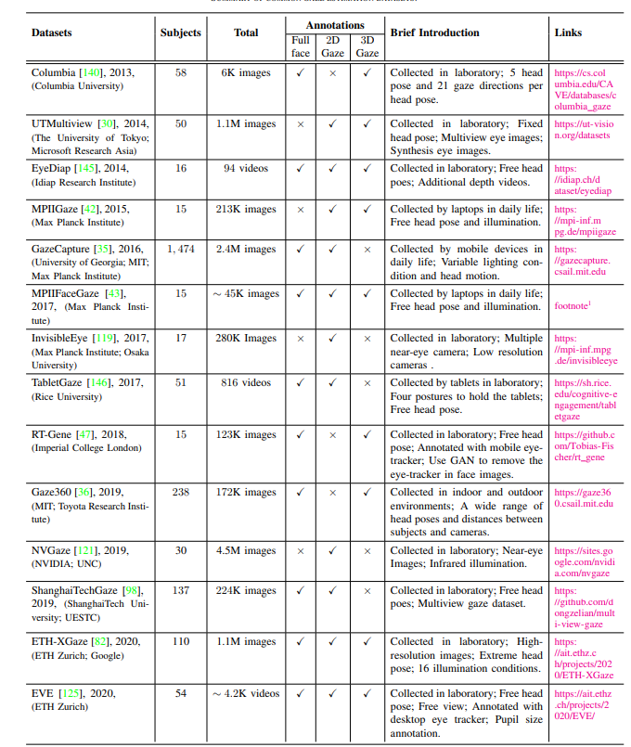
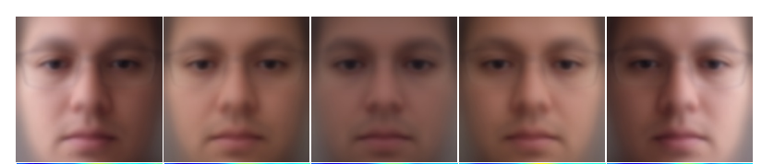
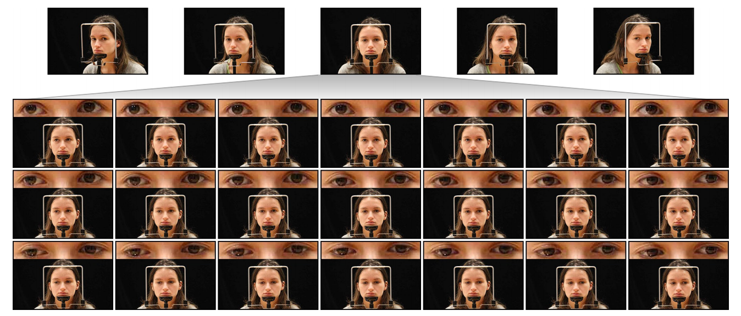
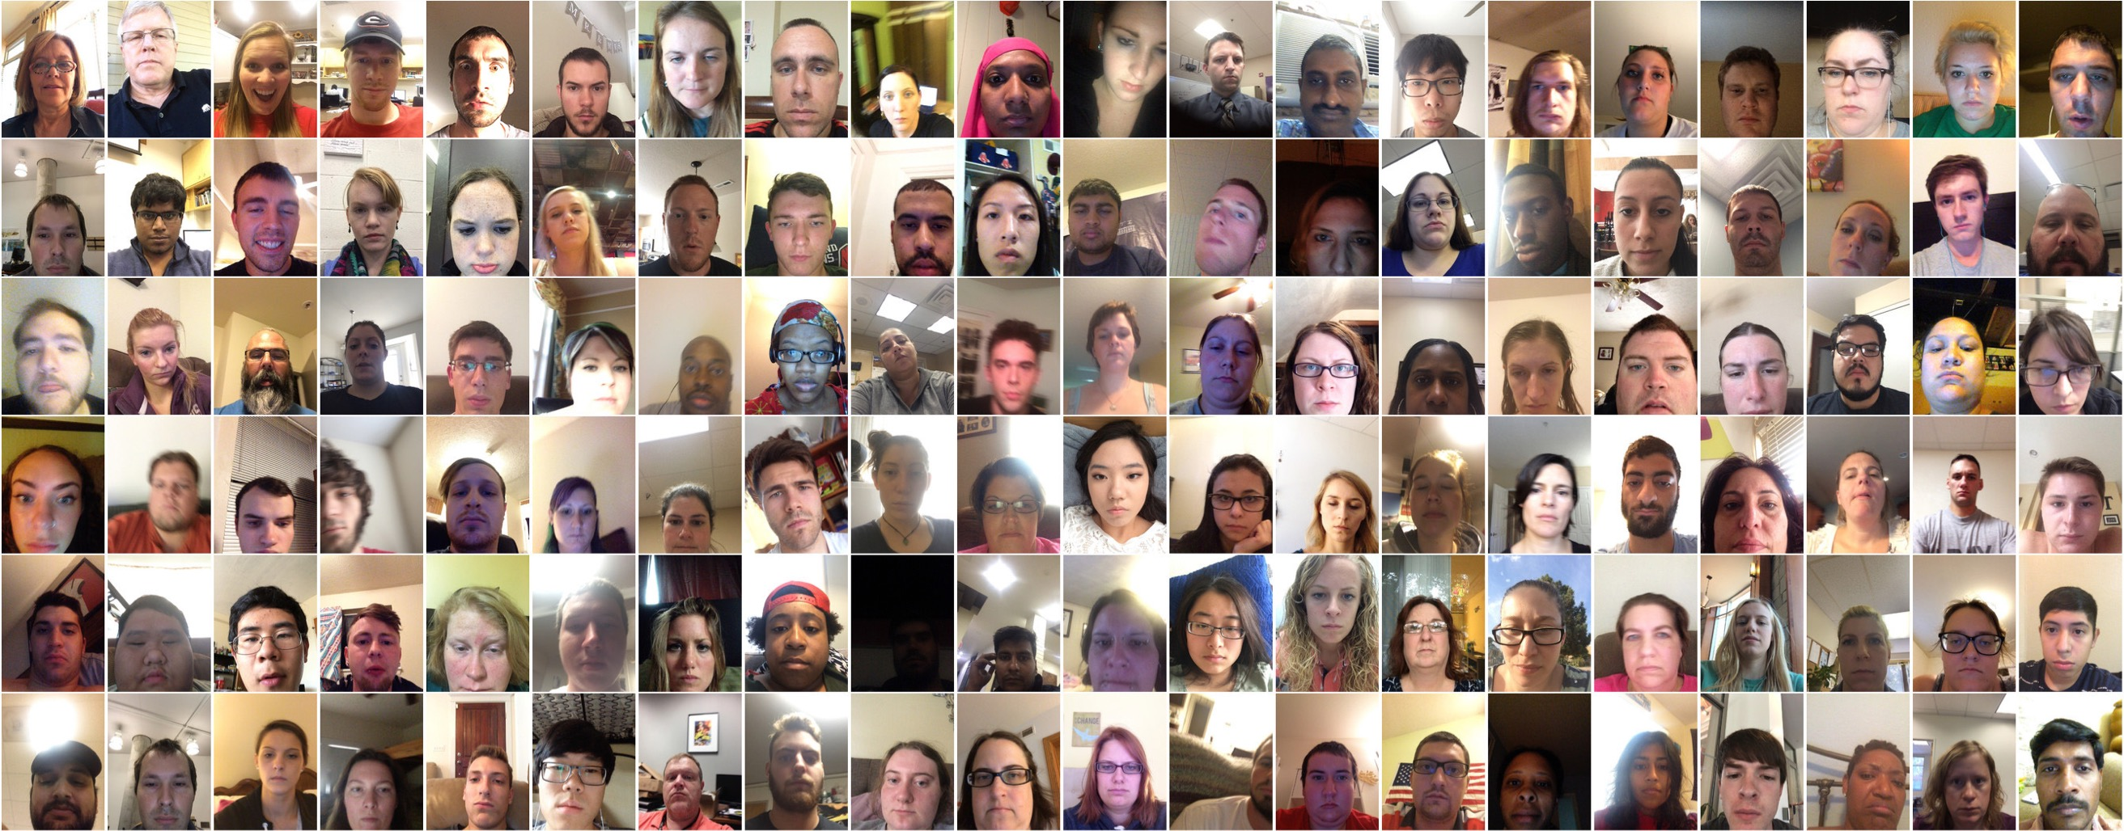

Slide 26
